Slide 1
Technical lessons learned
Don’t try this at home kids!

Slide 2
Application flow
Controller
View
GET Request
request
Mapper
Dto
Service
Repository
Entity
data
DB

Slide 3
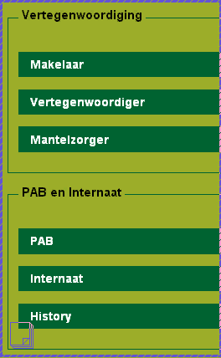
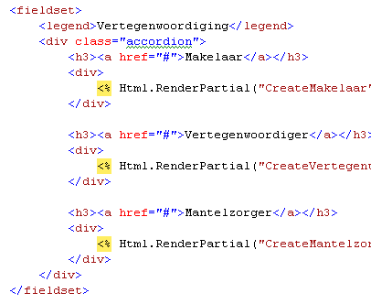
UI: jQuery
Script
View

Slide 4
UI: Microsoft’s MVC
Model
View
Controller
public class ZorgbehoevendeController : Controller
{
public ActionResult Detail(string id)
{
var zorgbehoevende = zorgbehoevendeService.GetZorgbehoevende(id);
return View(zorgbehoevende);
}
public ActionResult Create(ZorgbehoevendeDto dto)
{
var id = zorgbehoevendeService.CreateZorgbehoevende(dto);
return RedirectToAction("Detail", id.ToIdRoute());
}
}

Slide 5
Domain: Mapping
public class Memo : Entity
{
public DateTime Datum{ get; protected set; }
public string Auteur { get; protected set; }
public string Inhoud { get; protected set; }
public Memo(DateTime date, string auteur, string inhoud)
{
Datum = date;
Auteur = auteur;
Inhoud = inhoud;
}
}
public class ViewMemoDto
{
public string Datum { get; set; }
public string Auteur { get; set; }
public string Inhoud { get; set; }
}
var memos = Map.These(user.Memos).ToAListOf<ViewMemoDto>();
Mapper.CreateMap<Memo, ViewMemoDto>();
Mapper.CreateMap<DateTime, string>()
.ConvertUsing(d => d.ToScreenDate());

Slide 6
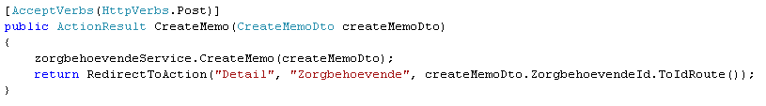

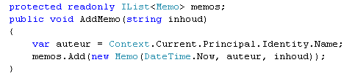
Domain Driven Design
Zorgbehoevende Controller
Zorgbehoevende Service
Zorgbehoevende Entity

Slide 7
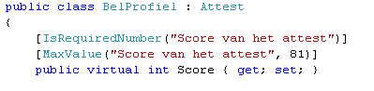
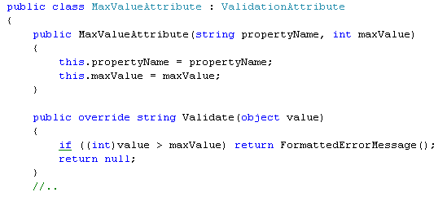
Domain: Validation with attributes
Aanvraag Service
Attest Entity
Attribute

Slide 8
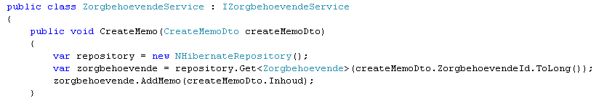
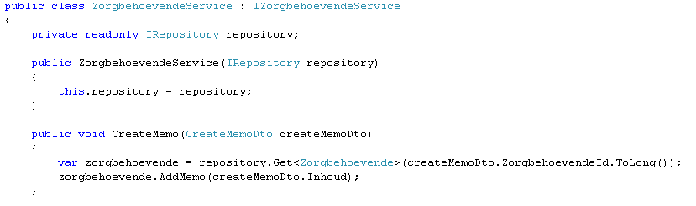
Domain: Loose coupling
Dependency
Dependency Injection

Slide 9
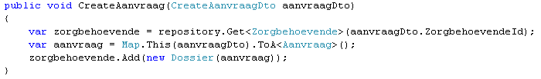
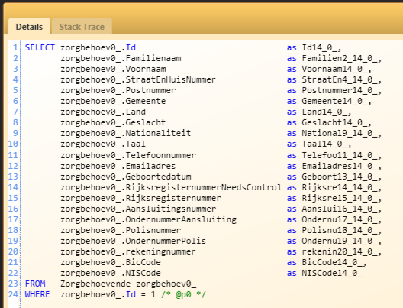
Data: Nhibernate

Slide 10
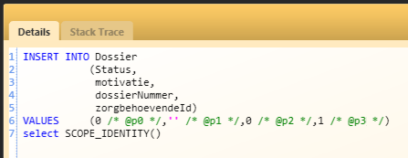
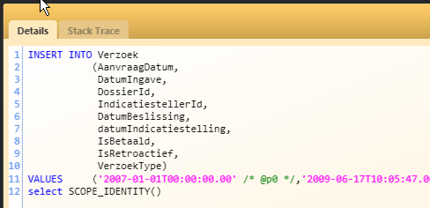
Data: Nhibernate

Slide 11
Data: Migratordotnet

Slide 12
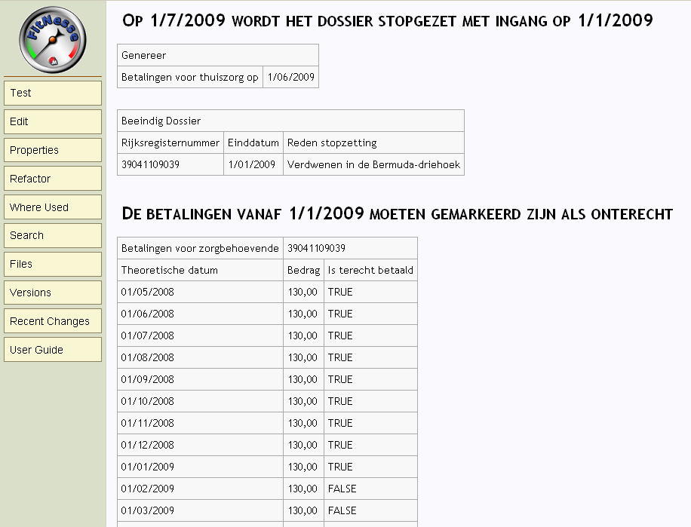
Practices: Specification by example uisng FitNesse

Slide 13
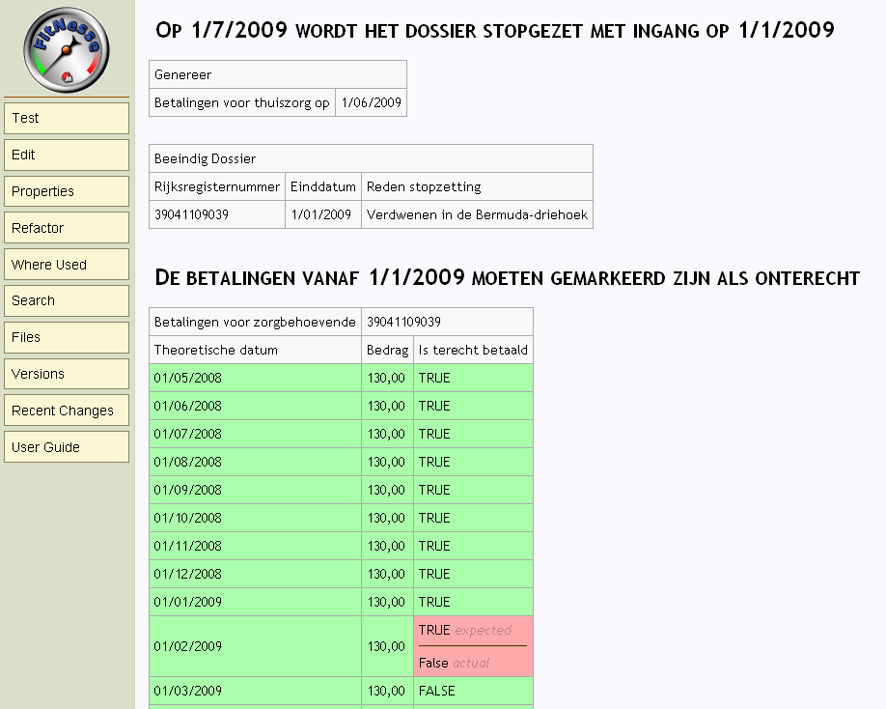
Practices: Specification by example uisng FitNesse

Slide 14
Practices: TDD/BDD/AAA

Slide 15
Practices: Pair Programming

Slide 16
Practices: Readability
Extension methods and lambda expressions
if (attest.Datum.IsInTheFuture())
{ //...}
if (attest.Datum.IsBetween(1.Januari(2009), 31.December(2009)))
{ //...}
When(repository)
.IsToldTo(r => r.Get<Zorgbehoevende>(zorgbehoevendeId))
.Return(zorgbehoevende);

Slide 17
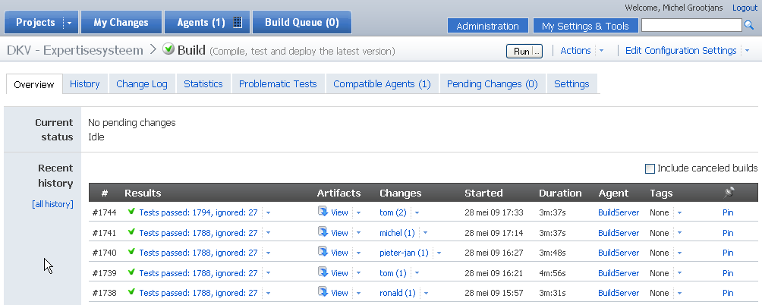
Buildesrver: TeamCity

Slide 18
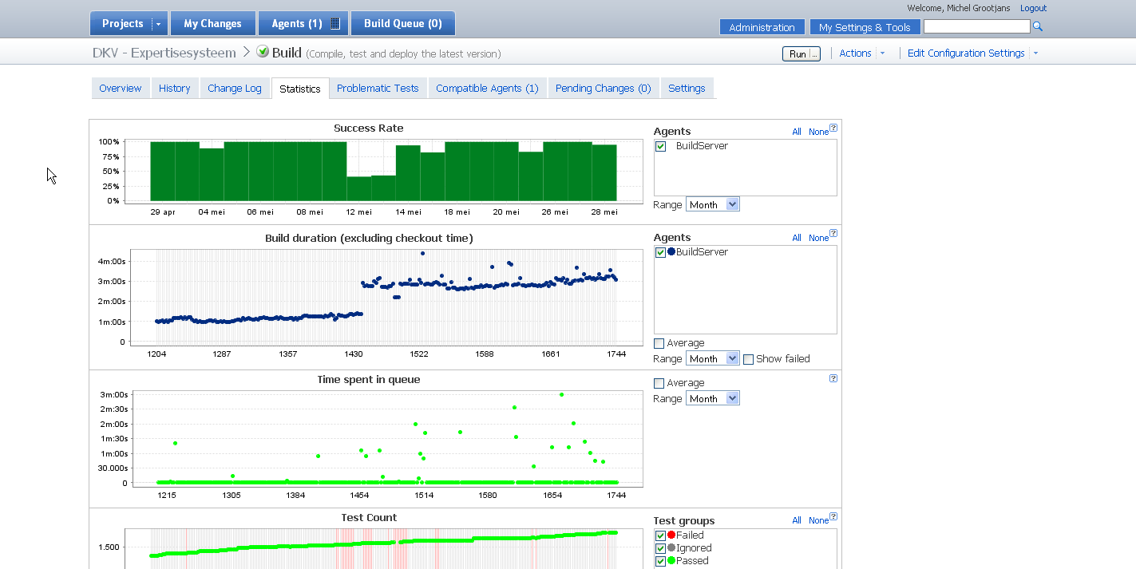
Buildesrver: TeamCity

Slide 19
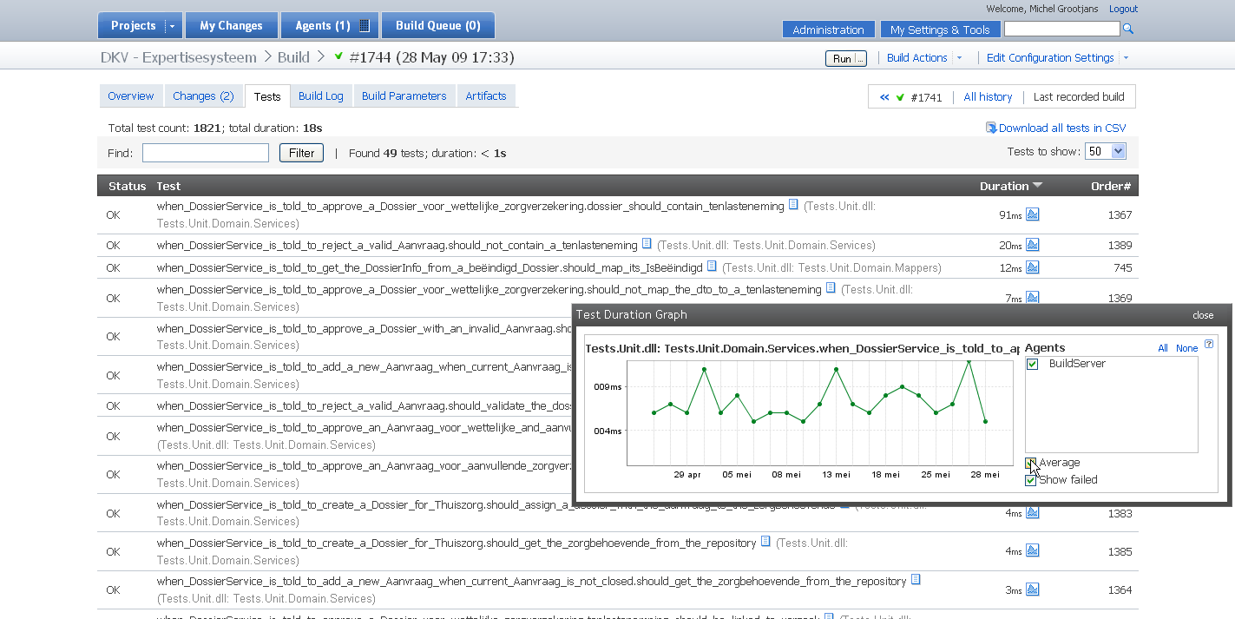
Buildesrver: TeamCity

Slide 20
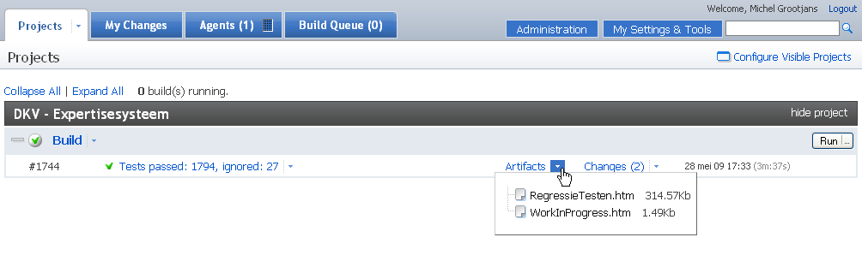
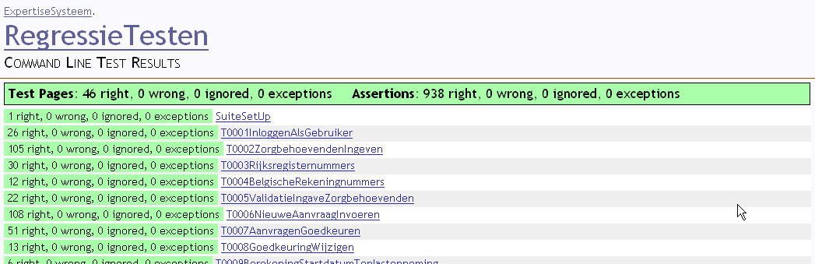
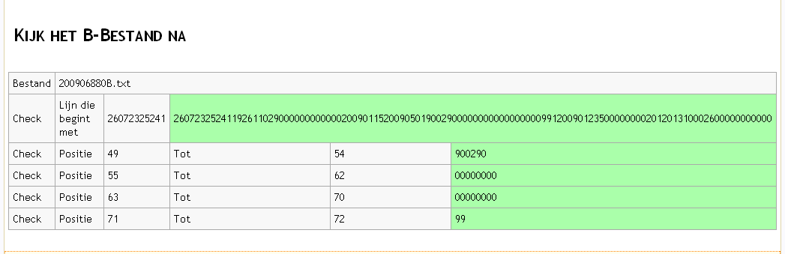
Buildesrver: TeamCity

Slide 21
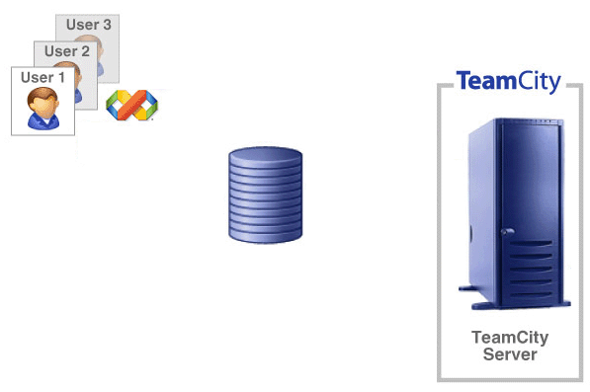
ALM: TeamCity with Subversion - A Perfect match!
Edit
Commit
Verify
SVN

Slide 22
ALM: TeamCity with Subversion - A Perfect match!
Edit
Verify
Commit
SVN

